Slide 1


Lecture 2 Machine learning and computational analysis July 11, 12 (1.5 hours)
Steven G Rozen
steverozen@gmail.com
Duke-NUS Medical School,
Singapore
Mutational Signatures Tutorial
11-12 July 2020
Notes:
25 minute talk

Slide 2
Role of mutational signatures in research
Lecture 1
Introduction and experimental study of causes of mutational signatures
Lecture 2
Machine learning and computational analysis in large databases
Discovery
Analysis of large databases
Experimental elucidation
Mutational Signatures
Lecture 3
Differences across the genomic landscape and new understanding
of DNA damage and repair
Molecular cancer epidemiology
How do mutations cause cancer?
Understanding
of DNA damage and repair
Prevention and screening
Cancer life histories and signature-associated oncogenic pathways
Application
Specific therapeutic opportunities

Slide 3
What questions do we want to answer?
“Extraction” / Discovery Given a large number of spectra, what mutational signatures are present? (I.e. mutational signatures are latent variables to be discovered.) And how many mutations are caused by each extracted signature in each spectrum? (“Attribution”)
“Attribution only” Given known mutational signatures and one or more spectra, how many mutations in each spectrum were caused by each signature?
Other questions:
“Signature presence test” Given known mutational signatures, including a mutational signature of interest, what is the evidence that the signature of interest is present in a set of spectra spectra? Which spectra?
“Novel signature test” Given known mutational signatures and one or more spectra, what is the evidence that there is a novel signature present?

Slide 4
What questions to we want to answer?
“Extraction” / Discovery Given a large number of spectra, what mutational signatures are present? (I.e. mutational signatures are latent variables to be discovered.) And how many mutations are caused by each extracted signature in each spectrum? (“Attribution”)
“Attribution only” Given known mutational signatures and one or more spectra, how many mutations in each spectrum were caused by each signature?
Other questions:
“Presence Test” Given known mutational signatures, including a mutational signature of interest, and a single spectrum, what is the evidence that the signature of interest is present in the spectrum?
“Novel Signature Test” Given known mutational signatures and one or more spectra, what is the evidence that there is a novel signature present?

Slide 5
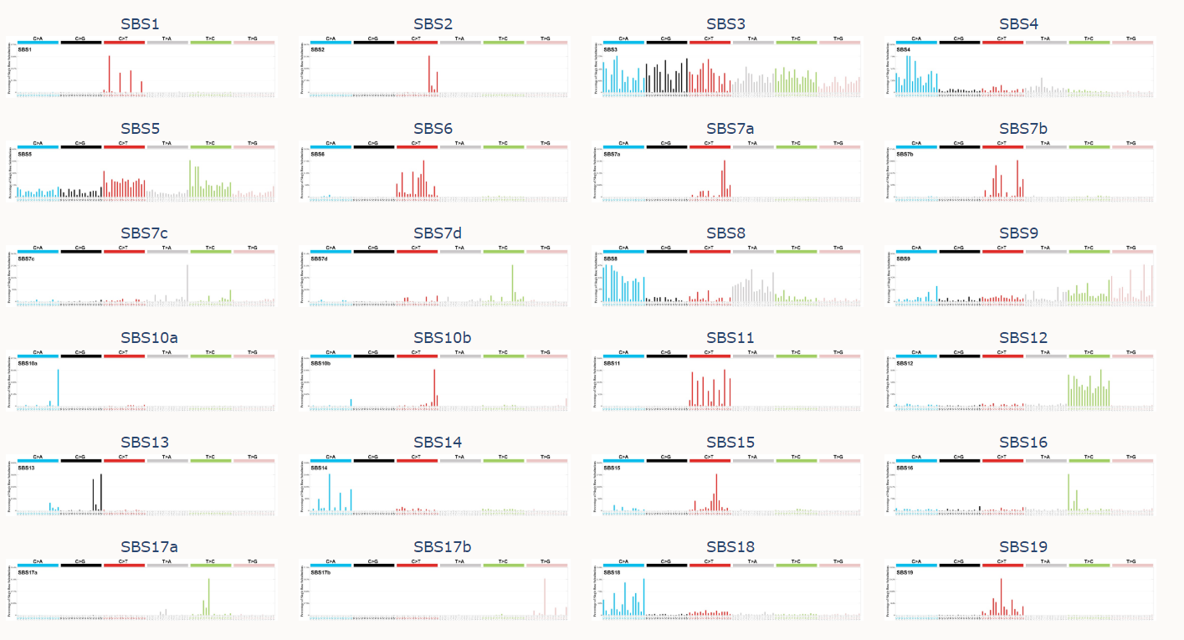
Why would you want to do signature extraction?
Many signatures have been extracted and confirmed by additional evidence
It is possible to estimate which known signatures are present in a spectrum or set of spectra
…
and many more
https://cancer.sanger.ac.uk/cosmic/signatures/index.tt

Slide 6
Why would you want to do signature extraction?
Many people will actually be more interested in
Assigning known signatures to their spectra
Determining if a specific signature is present or not in a given specturm
Determining if there a novel signature in their spectra
But, maybe
You are looking for new signatures in a new or expanded set of spectra
You think you have an approach for more useful delineation of signatures in existing data or for discovering previously overlooked signatures
You want to confirm previous extractions
You have new data and want to take an unbiased look at it before trying to match to previously described signatures
Warning: signature extraction will usually not work well on small sets of spectra
If you have a new, smallish set if spectra, may want to combine with existing data before doing signature extraction

Slide 7
Signature extraction – orientation

Slide 8
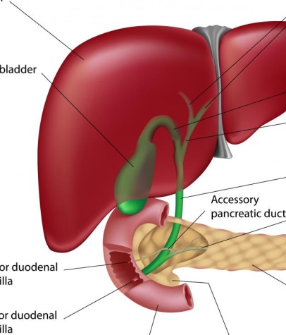
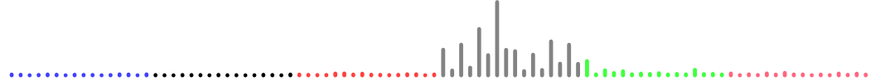
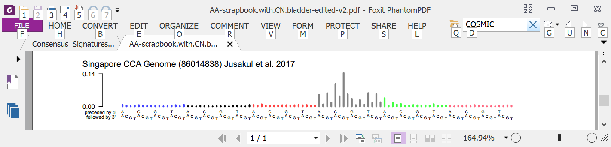
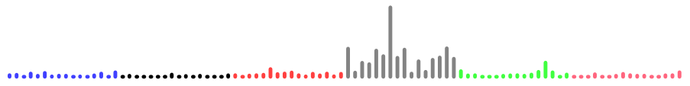
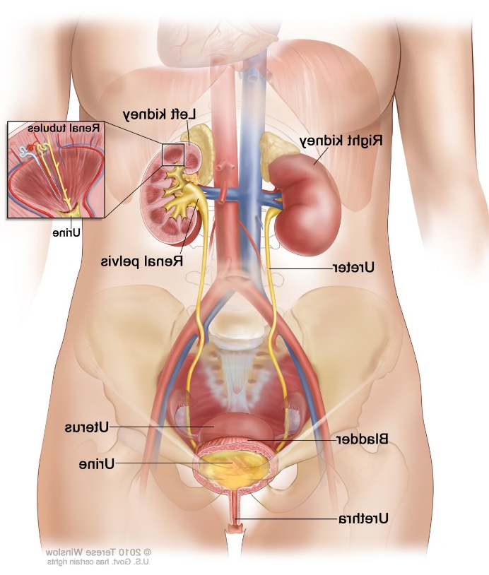
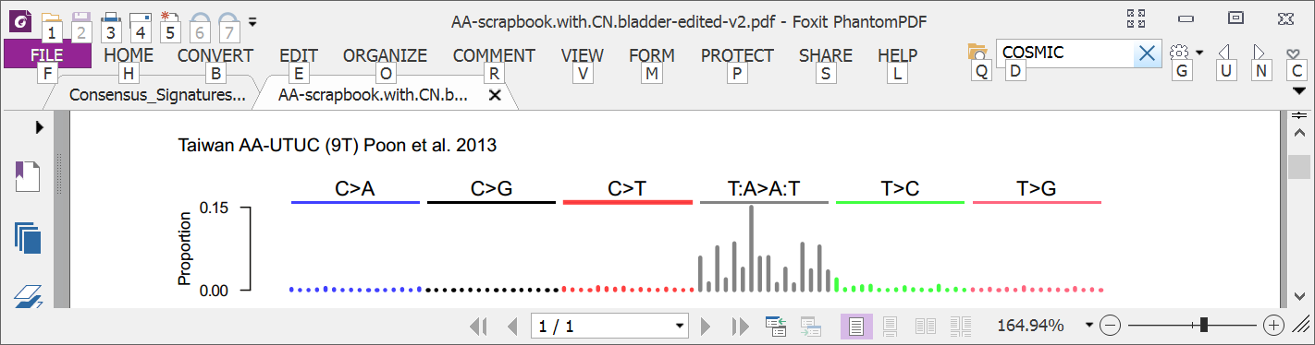
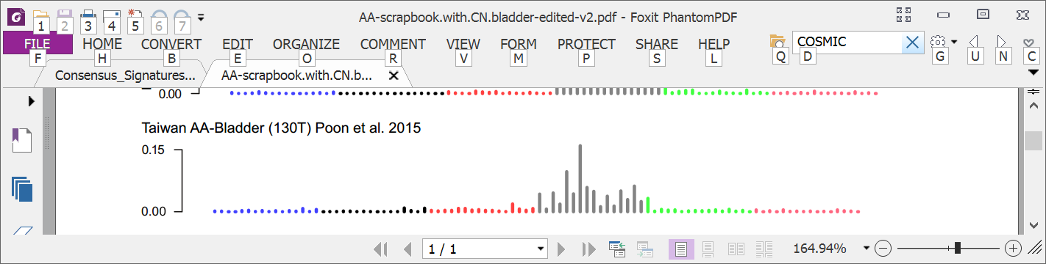
Sometimes a spectrum is dominated by 1 signature (Herbal medicine aristolochic acid mutations in multiple cancer types)
Liver
Bile duct
Kidney
Upper tract urothelial
Bladder
Poon et al., 2013 and subsequent data (liver - hepatocellular carcinoma [HCC])
Zou et al., 2015, Jusakul et al., 2017 (bile duct carcinoma)
Scelo et al., 2014, Jelakovic et al., 2014 (kidney/renal cell carcinoma)
Poon et al., 2013, Hoang et al., 2013, many others (upper tract urothelial carcinoma)
Poon et al., 2015, others (bladder urothelial carcinoma)

Slide 9
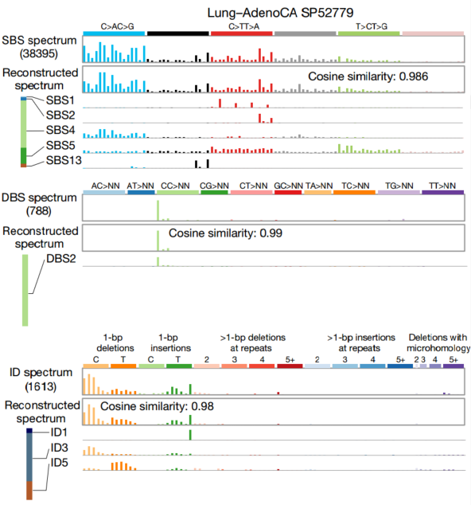
More often spectra are sums of the effects of multiple signatures
Lung adenocarcinoma
C>A C>G C>T T>A T>C T>G

Slide 10
We can tease apart signatures in large sets of spectra by data mining
Two mathematical approaches:
Non-negative factorization based approaches
Example, SigProfilerExtractor
Approaches based on probabilistic topic models
Example, an approach using hierarchical Dirichlet processes
These are unsupervised machine learning approaches
All methods seem to face similar challenges
Signature discovery is not a purely algorithmic process
The granularity of extracted signatures and the features considered depend on the larger questions you are considering

Slide 11
“All models are wrong but some are useful”
George E. P. Box (1979), "Robustness in the strategy of scientific model building", in Launer & Wilkinson, Robustness in Statistics
Mutational signatures are models
To assess the quality of mutational signature extraction, attribution, or presence testing, we need to consider the intended use
11

Slide 12
Synthetic data from SynSigGen package
Input (based on previous analysis of PCAWG tumors):
E, matrix of exposures (signatures X samples)
S, mutational signature profiles (mutation type X signature)
Parameters <- generate from E
Based on proportion of tumors with the signature in E and the mean and sd of log of mutation counts for each signature in E
Ground.truth.synthetic.exposures <- generate synthetic exposures(Parameters)
(optional) add noise (resample) the exposure to each signature in each synthetic sample/tumor
Ground.truth.synthetic.spectra <-
CreateSyntheticSpectra(S, ground.truth.synthetic.exposures)
Analysis.results <- Analyze synthetic.spectra
Compare Analysis.results to ground truth synthetic exposures and spectra
(remotes::install_github("steverozen/SynSigGen"))

Slide 13
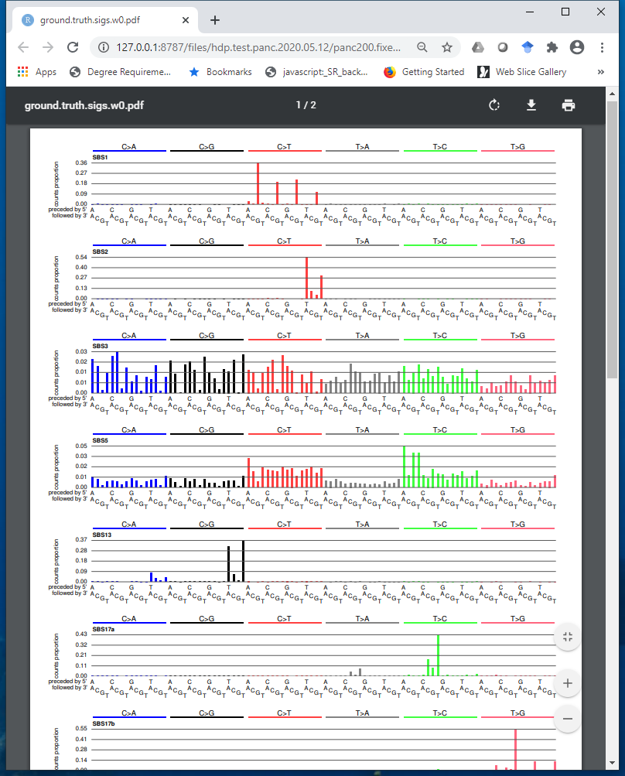
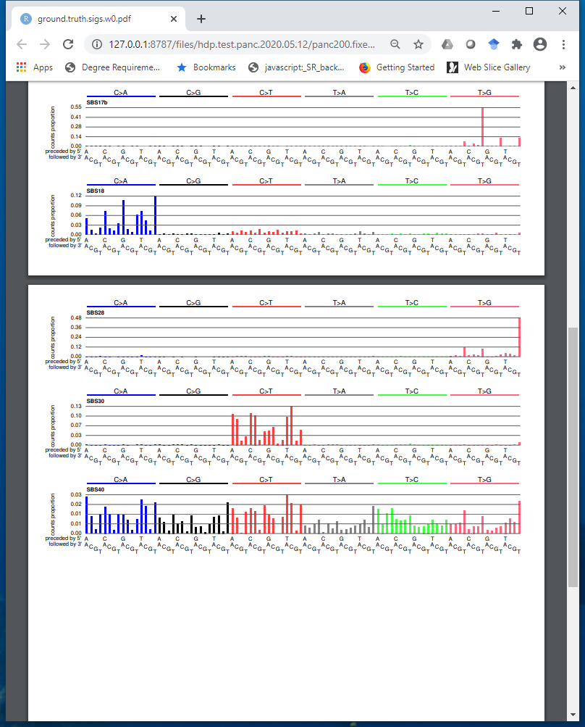
Synthetic data set mimicking pancreatic adenocarcinomas
11 Signatures COSMIC v3 SBS1, 2, 3, 5, 15, 17a, 17b, 18, 28, 30, 40

Slide 14
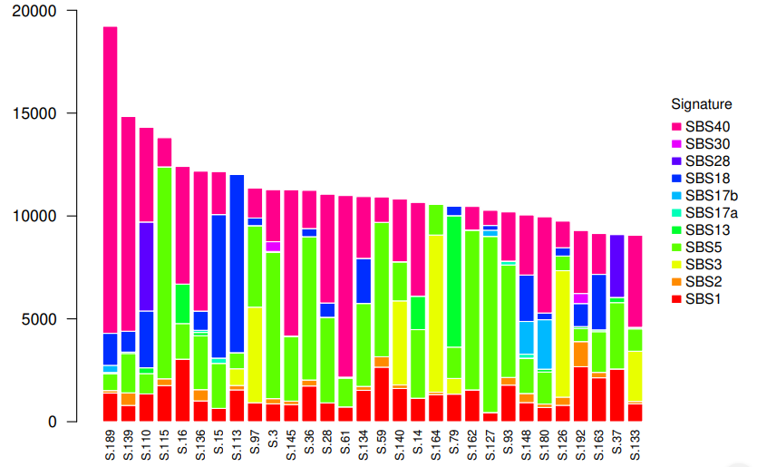
Synthetic data set mimicking pancreatic adenocarcinomas, exposures

Slide 15
Signature extraction (discovery) Approaches based on Non-negative Matrix Factorization (NMF)

Slide 16
Many techniques for extraction are based on non negative matrix factorization (NMF)
Each cell contains level of exposure of 1 tumor to 1 signature
23,000 tumors
W
X
H
N
signatures
96 mutation types
23,000 tumors
N
signatures
≈
V (observed mutations)
96 mutation types

Slide 17
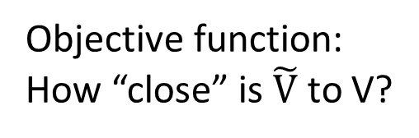

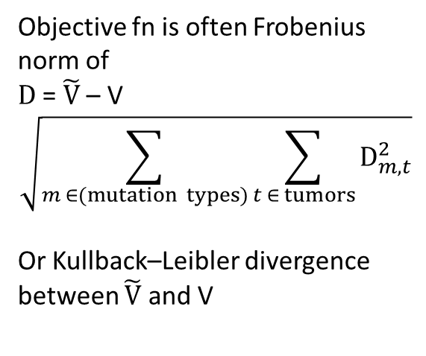
Many techniques for mutational signature extraction are based on non negative matrix factorization (NMF)
Each cell contains level of exposure of 1 tumor to 1 signature
Objective fn is often Frobenius norm of
D = $\tilde{V}$ – V
$$\sqrt{\sum_{m ∈(mutation types)}{\sum_{t ∈ tumors}{D_{m,t}^{2}}}}$$
Or Kullback–Leibler divergence between $\tilde{V}$ and V
23,000 tumors
W
X
H
N
signatures
96 mutation types
23,000 tumors
N
signatures
=
$\tilde{V}$ = W x H
96 mutation types
Objective function:
How “close” is $\tilde{V}$ to V?
≈
V (observed mutations)

Slide 18
General observations on NMF
NMF is a collection of algorithms and techniques
The best approximate factorization depends on the objective function
As for many unsupervised learning approaches, determining the number of items (signatures) to discover is challenging
Need to avoid overfitting (so often do multiple factorizations on e.g. bootstrapped data)

Slide 19
NMF case study: SigProfilerExtractor
Developed to supersede the MATLAB code used in Alexandrov 2013 and 2020
Part of a suite of software, other functions include:
SigProfilerMatrixGenerator (functionality overlaps ICAMS)
SigProfilerSingleSample
SigProfilerSimulator
Latest release: https://pypi.org/project/sigproextractor/
https://github.com/AlexandrovLab
Documentation at https://osf.io/t6j7u/wiki/3.%20Using%20the%20Tool%20-%20Output/
Under rapid development – details and algorithms may change

Slide 20
SigProfilerExtractor runs NMFs over multiple iterations of bootstrapped data
Purpose, to avoid overfitting
Multinomial resampling of counts for mutation types (e.g. ACA > AAA, ACC > AAC, … TTT > TGT) for each tumor based on the observed total mutation count in the tumor and the proportion of counts of each mutation type.
Recommends 100; user smaller number for initial testing
Recommend to run several times with different seeds; if solutions are different, run more NMF iterations
More info in Alexandrov et al 2013 and 2020:
http://dx.doi.org/10.1016/j.celrep.2012.12.008
https://doi.org/10.1038/s41586-020-1943-3

Slide 21
(Review) Signatures in synthetic data mimicking pancreatic adenocarcinomas
11 Signatures COSMIC v3 SBS1, 2, 3, 5, 15, 17a, 17b, 18, 28, 30, 40

Slide 22
(Review) Synthetic data set mimicking pancreatic adenocarcinomas, exposures (attributions) to signatures

Slide 23
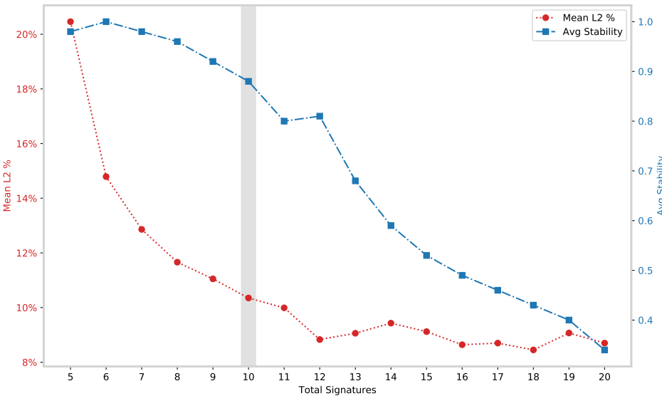
SigProfilerExtractor: Selecting the number of signatures
Mean L2% is the average across samples of the percent Euclidian reconstruction error (low is good)
Average stability is the mean across NMF iterations of silhouette coefficient of the clusters of proto-signatures (indicates how well the proto-signatures are clustered into signatures – high is good)
If Avg Stability is very jagged might try increasing the number of NMFs

Slide 24
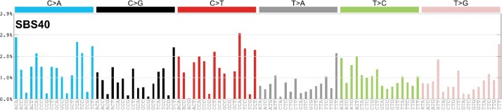
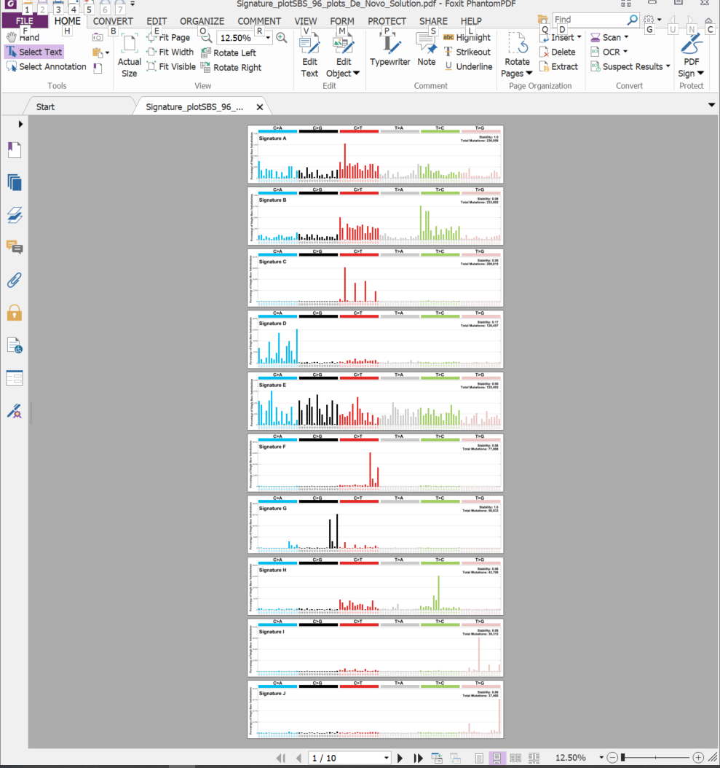
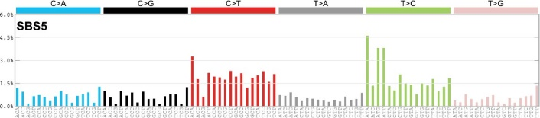
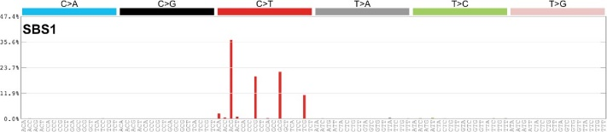
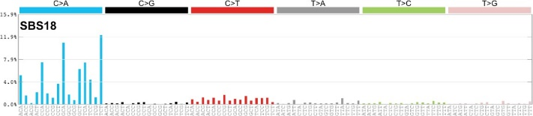
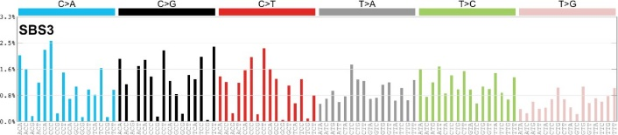
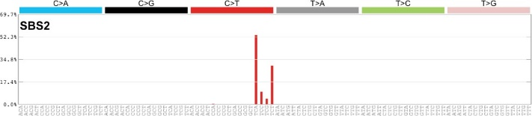
Most extracted signatures good match to ground truth (6 of 11 shown)
Ground truth
Extracted

Slide 25
Most extracted signatures good match to ground truth (6 of 11 shown)
Ground truth
Extracted
“Bleeding” of CG > TG mutations from SBS1 to SBS40-like extracted signature

Slide 26
Known issues with approaches based on non-negative matrix factorization (NMF)
The number of signatures is a judgement call (some approaches deal with this)
Weak signatures cannot be discovered in background of strong signatures
Signatures can be imperfectly separated (“bleeding” and “stealing” between signatures)
More generally, recovered signatures depend strongly on exact set of tumours studied
Lowest error reconstruction often involves many signatures, some with very low contributions, and often not biologically plausible (see following slides)
Signature discovery (extraction) is not a purely algorithmic process
In practice, discovering signatures (“extraction”) needs to be separated from estimating exposures (“attribution”)
!

Slide 27
Common misconception
Signatures that, when combined, give the most accurate reconstruction of a spectrum are the best ones

Slide 28
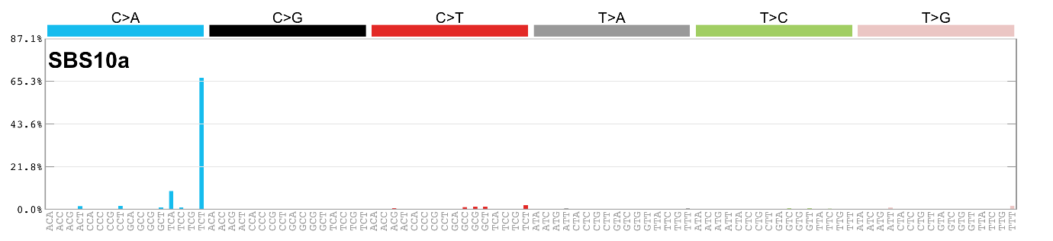
Extreme example:
A set of 96 signatures, each of one single base substitution in trinucleotide context will yield perfect reconstruction and zero biological insight

Slide 29
Signature discovery is not a purely algorithmic process: How to assess results (1)
The input data have been examined for sequencing and mapping artifacts (some which are well-known); mapped reads supporting unusual patterns have been examined in a read-alignment viewer or have been experimentally verified
Look for external supporting evidence
Correlation with known or expected mutagenic exposures, eg
cigarette smoking
Aflatoxins
AA-containing herbs
Haloalkanes
Age
UV radiation
Correlation with known or expected genetic causes, eg
polymerase epsilon proofreading defects
mismatch repair deficiency
homologous recombination repair deficiency (BRCA)
Can be tied to known biochemical processes (eg guanine adducts and signatures with C:G > N:N mutations)

Slide 30
Signature discovery is not a purely algorithmic process: How to assess results (2)
Association with genomic features that interact with DNA repair
Transcription strand bias
Replication strand / timing
Homopolymers (indels)
Look for supporting evidence within the data set
Samples dominated by a single signature
Signature is consistently deciphered from multiple independent datasets using different techniques or hyperparameters
Absence of known problems (next slides)
More info at https://static-content.springer.com/esm/art%3A10.1038%2Fs41586-020-1943-3/MediaObjects/41586_2020_1943_MOESM4_ESM.pdf, pages 6 & 7
Look for known issues with signature discovery

Slide 31
Known problems: bleeding
Ground truth (synthetic data)
Extracted
“Bleeding” or incomplete separation of some CG > TG mutations from SBS1 to SBS40-like extracted signature
31

Slide 32
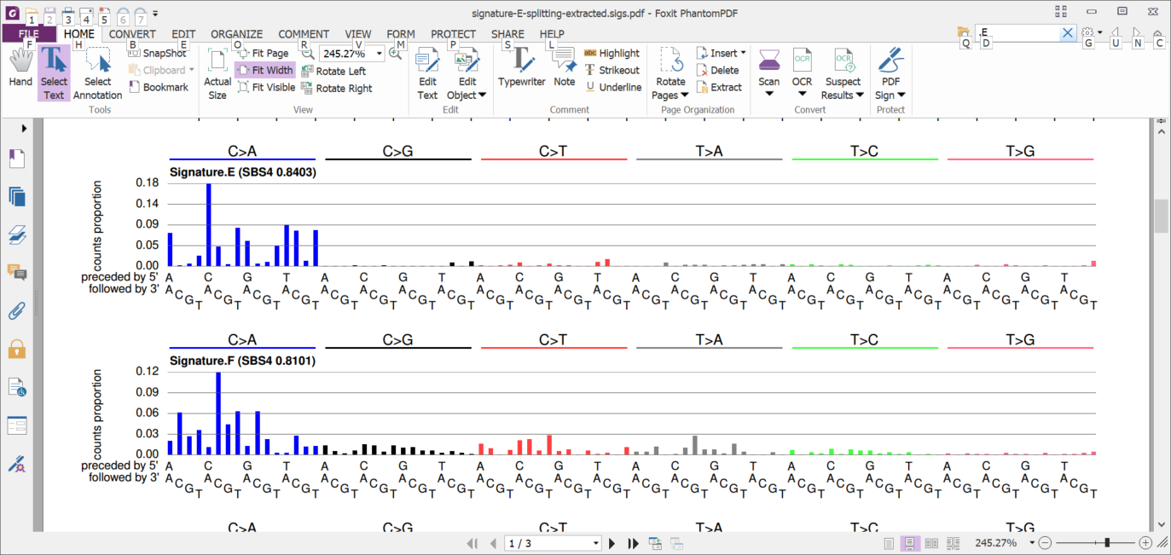
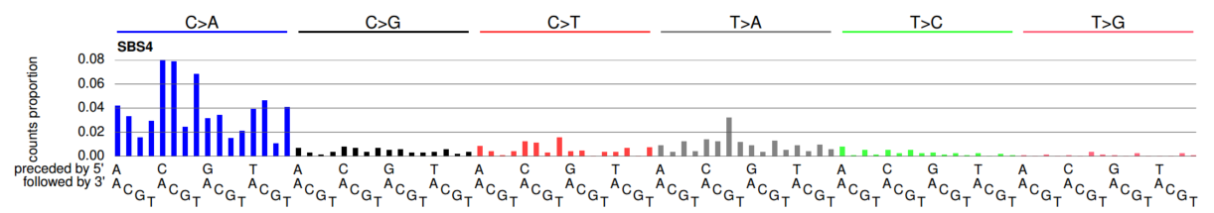
Known problem: over-splitting (from a different synthetic data set)
+
2 extracted signatures
≈
1 ground-truth signature

Slide 33
Important to think about why you are doing signature discovery
Are you trying to find novel signatures?
Are you trying to determine which signatures are present?
Or more likely, trying to determine which known signatures are present and if there are any novel signatures
Are you trying to estimate presence / absence or level of exposure to a particular signature, and perhaps tie these to clinical or population factors?
Some of these might be better and more easily conceptualized as signature attribution problems, rather than signature discovery problems (especially if only a small number of tumors or exome (as opposed to genome) data

Slide 34
Attribution and problems with attribution: The need to consider all available evidence

Slide 35
Central techniques based on non negative matrix factorization (NMF)
Each cell of H contains the number of mutations in 1 tumor due to 1 signature
23,000 tumors
W
X
H
K
signatures
96 mutation types
23,000 tumors
K
signatures
≈
V (observed mutations)
96 mutation types
Each cell of V contains the number of mutations of 1 type (e.g. CTG > CAG) in 1 tumor

Slide 36
For Attribution: Fix the signatures, fit the exposures by standard constrained linear optimization approaches
Solve for the exposures
W
96 mutation types
X
N
signatures
H
N
signatures
≈
96 mutation types
V (observed mutations)
Fix the signatures
Very few
tumours

Slide 37
Sparsity and plausibility
Signatures that, when combined, give the most accurate reconstruction of a spectrum are the best ones
Adding more signatures in tiny amounts usually improves reconstruction even if activity of signatures is biologically implausible
Not useful for deciding if a mutational signature is present to a biologically meaningful extent

Slide 38
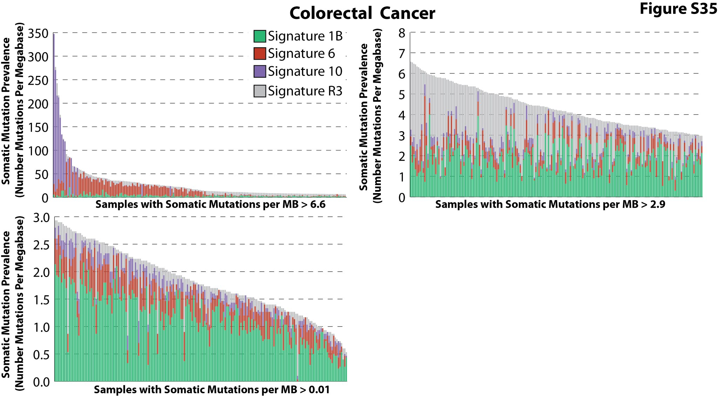
Lack of sparsity: every signature is in (almost) every tumor A problem in earlier the predecessors of SignatureProfiler
Real MMR deficient
tumors
Attribution of MMR signature improves reconstruction of spectra but is useless for understanding biology
Alexandrov, 2013
Signature 6 (dark red) is a signature of mismatch repair (MMR) deficiencty
(microsatellite instability) in colon tumors
Almost every tumor has Signature 6, but in reality most colon tumors do NOT have MMR deficiency

Slide 39
Lack of sparsity (close up)
Alexandrov, 2013

Slide 40
Extracted signatures good match to ground truth (6 of 11 shown)
Ground truth
Extracted

Slide 41
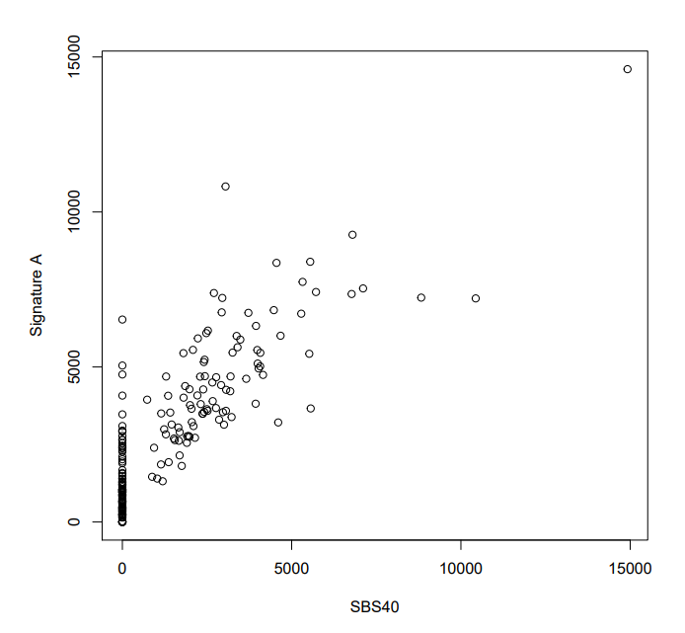
SigProfilerExtractor attribution example SBS40
Inference
Truth

Slide 42
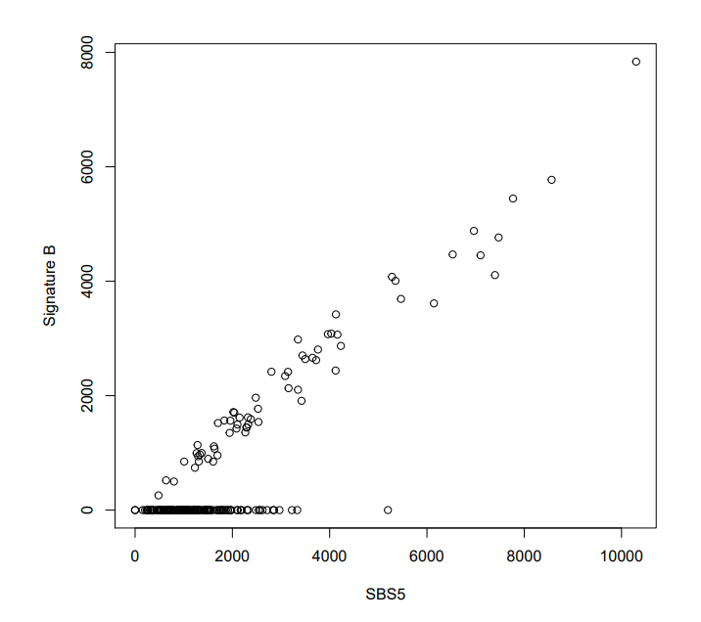
SigProfilerExtractor attribution example SBS5
Inference
Truth

Slide 43
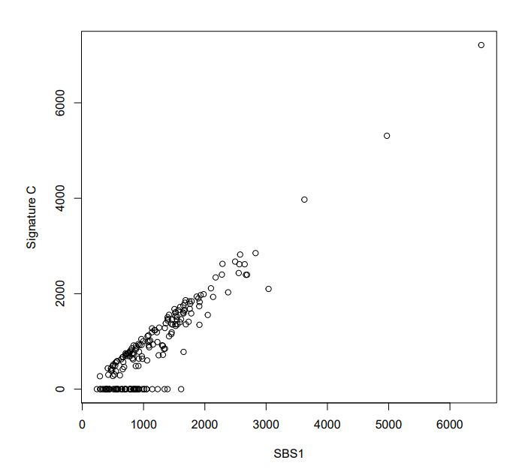
SigProfilerExtractor attribution example SBS1
Inference
Truth

Slide 44
General issues with attribution
Not studied very thoroughly
With enough signatures, adding more signatures almost always improves reconstructions
Issues of sparsity (tiny exposures to many signatures)
Issues of biological plausibility
Common examples:
ultraviolet signatures in tumors with no possibility of UV exposure
Single base substitution signatures of microsatellite instability in tumors that clearly do not have microsatellite instability
Signatures of defective polymerase epsilon proofreading (which generates very high numbers of mutations) with very low mutation counts (and no defect in the polymerase epsilon gene).

Slide 45
Summary so far
Discussed signature extraction (data mining) and attribution
Showed approach to generate synthetic data
Extraction and how to assess results in context
Determining number signatures is central
Attribution and how to assess results in context
Example of a non-negative matrix factorization approach, SigProfilerExtractor
Attribution examples from SigProfiler
Signature discovery and attribution are not purely algorithmic activates; they require assessment of all available evidence
Challenges are generic, not restricted to SigProfiler (to be covered in Part 2 of this lecture)

Slide 46

Signature extraction (discovery) Approaches based on Hierarchical Dirichlet Processes (HDP) Incorporates by LIU Mo

Slide 47
Review why and what we are doing, and how NMF-based approaches do it Slides 3, 16, 17

Slide 48
HDP approach to mutational signature extraction / discovery
Inspired by a method for computing probabilistic topic models in text mining
Mutational signature discovery is isomorphic with discovering topics in probabilistic topic models
Mutation types (e.g. ACT > AGT) ~ words
Mutational signatures ~ topics
In probabilistic topic models, a topic is represented by the frequencies of occurrences of various words

Slide 49
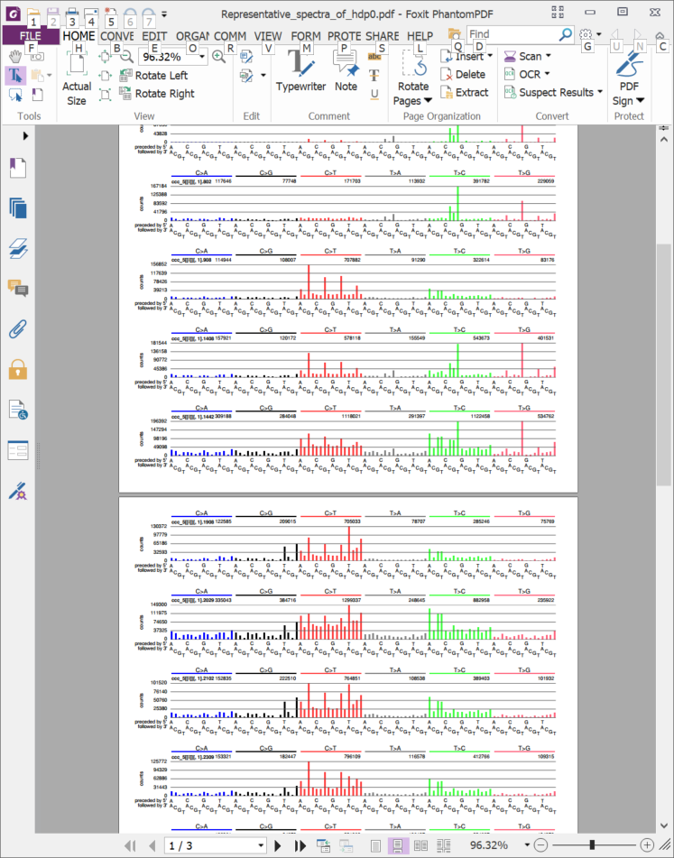
HDP for mutational signature discovery (1)
The conceptual focus is on assigning each mutation to a signature
The signature is a “raw cluster” of mutations generated by one abstract mutational process (which is modelled as a Dirichlet process)
Actually, the model groups mutations across all tumors into something we call “aggregated partial spectra” (this is the “raw cluster”)
The mutations are of different mutation types (e.g. ACT > AGT, ACT > ATT, ….) , but they belong to the same raw cluster

Slide 50
HDP for mutational signature discovery (1)
The signature profile is obtained by dividing the number of mutations of each type in the raw cluster (“aggregated partial spectrum) by the total number of mutations in the cluster
The number of raw clusters (“aggregated partial spectra”) is not bounded a-priori, but is discovered by the model; however, it is influenced to some extent by the hyperparameters that are priors on the Dirichlet process concentration parameters
In plainer language, these govern how easily the model will postulate an additional raw cluster (which indirectly govern how easily the model will postulate a new mutational signature

Slide 51
The software for HDP
We will describe software based on
C code from Yee Whye TEH (Teh, Jordan, Beal, Blei, 2006,
https://www.tandfonline.com/doi/pdf/10.1198/016214506000000302
http://papers.nips.cc/paper/2698-sharing-clusters-among-related-groups-hierarchical-dirichlet-processes.pdf
http://www.stats.ox.ac.uk/~teh/research/npbayes/npbayes-r21.tgz
R code from Nicola Roberts, who wrapped Teh’s code in R and mapped HDP to the problem of mutational signature discovery
https://github.com/nicolaroberts/hdp
https://www.repository.cam.ac.uk/bitstream/handle/1810/275454/Roberts-2018-PhD.pdf
R and C code from our lab that corrects some bugs and problems with the above and provides some convenience functions for applying HDP to mutational signature discovery and assessing it’s output (remotes::install_github(“steverozen/hdpx”), remotes::install_github(“steverozen/mSigHdp”)
Caution: the vocabulary and terminology are tricky, with different kinds of “samples” and “clusters”
Samples can be e.g. tumors or samples from a Gibb’s sampling Monte Carlo Markov chain
Clusters can the “raw cluster” of mutations or can be clusters of raw clusters (more usually called “components” – these are the “aggregated partial spectra” from multiple raw clusters added together)

Slide 52
The software for HDP as implemented by Roberts
Important: there are 2 phases to signature discovery
Part 1: Estimating “raw clusters” of mutations that approximate mutational signatures using a Gibb’s sampling method implemented by Teh
Tuning knobs: hyperparameters for the concentration parameters in the hierarchical Dirichlet process model (govern how easily it is to get a new raw cluster); parameters for the Gibb’s sampling including length of burnin and length of sampling chains; an initial guess of the number of raw clusters
Part 2: Aligning and merging raw clusters into signatures using clustering based on cosine similarity cutoffs and other parameters

Slide 53
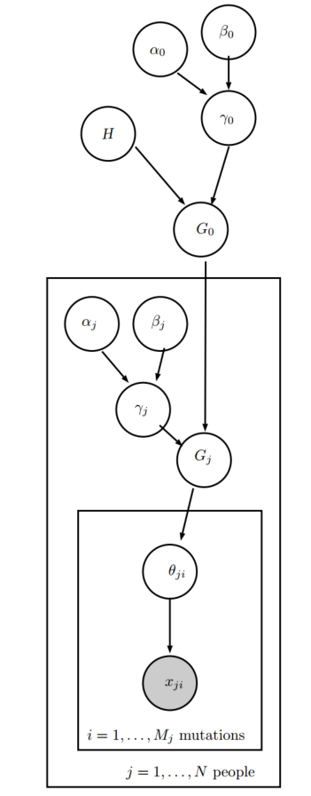
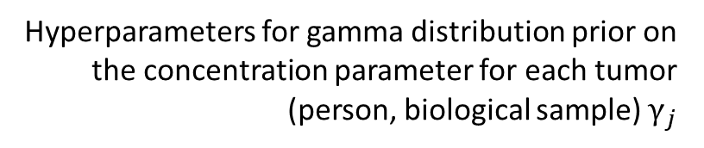
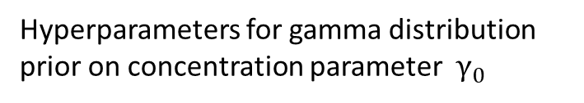
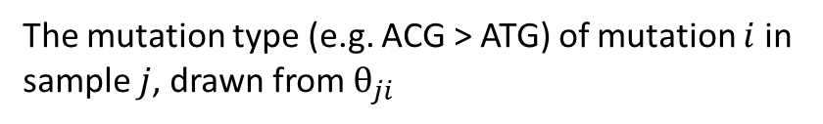
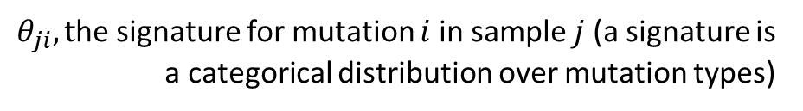
Part 1: Hierarchical Dirichlet process model for discovering mutational signatures
Hyperparameters for gamma distribution prior on concentration parameter $γ_{0}$
Uniform base distributions for signature profiles
Distribution of signatures drawn from a Dirichlet process with base distribution $H$ and concentration parameter $γ_{0}$
(Figure from Nicola Robert’s thesis)
Hyperparameters for gamma distribution prior on the concentration parameter for each tumor (person, biological sample) $γ_{j}$
Distribution of signatures drawn from a Dirichlet process with base distribution $G_{0}$ and concentration parameter $γ_{j}$
$θ_{ji}, t$he signature for mutation $i$ in sample $j$ (a signature is a categorical distribution over mutation types)
The mutation type (e.g. ACG > ATG) of mutation $i$ in sample $j$, drawn from $θ_{ji}$

Slide 54
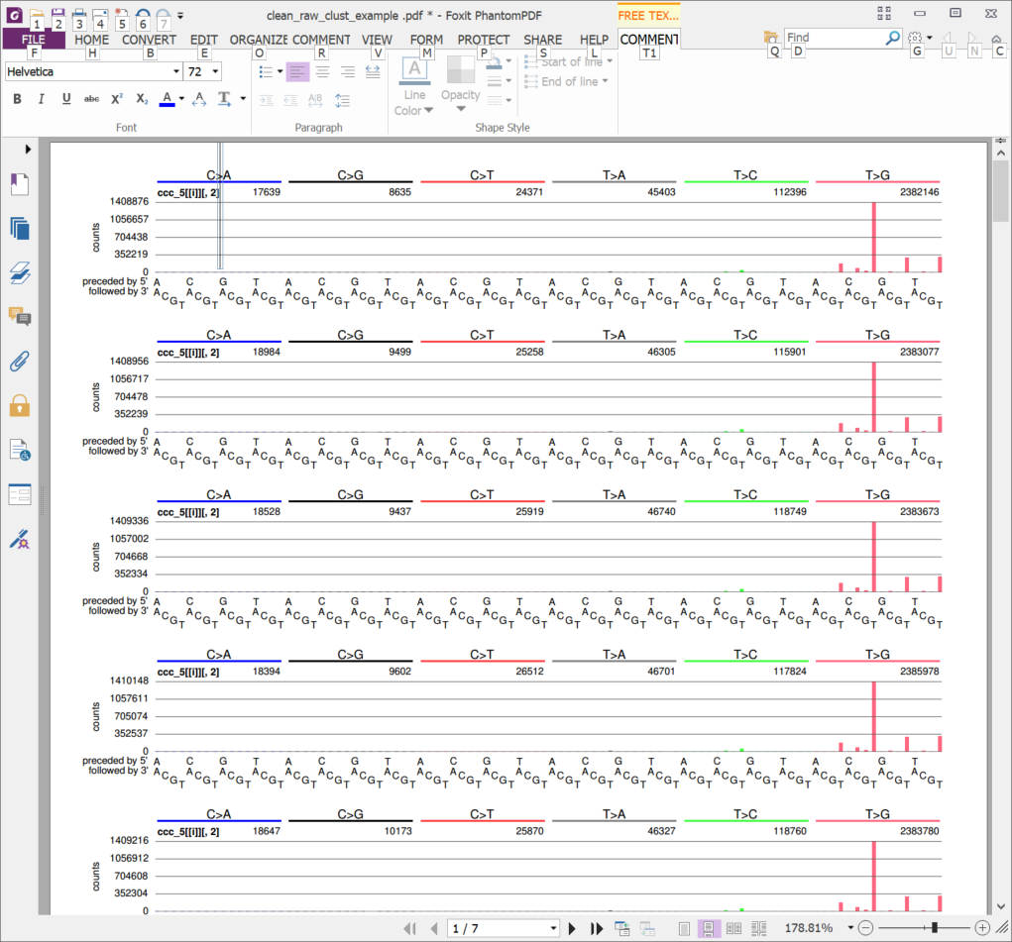
Part 1: Computing over the hierarchical Dirichlet process model (1)
Gibb’s sampling over the “Chinese restaurant franchise” representation of the hierarchical Dirichlet process (details outside the scope of this tutorial)
Each sampled point contains two important matrices
1. The number of mutations of each mutation type (e.g. ACT > AGT) in each raw cluster (“aggregated partial signature”, variable “classqq”)

Slide 55
Each of these is a “raw cluster” a.k.a. “aggregated partial spectrum” sampled at one point on the Gibb’s sampling chain
This is a raw cluster that is capturing mutations due to SBS17b
Note very large counts (e.g. 2,383,673). This is because this raw cluster capture SBS17b mutations across a set of 900 spectra

Slide 56
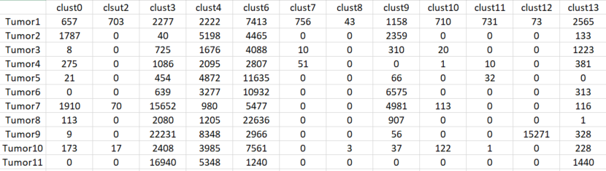
Part 1: Computing over the hierarchical Dirichlet process model (2)
Gibb’s sampling over the “Chinese restaurant franchise” representation of the hierarchical Dirichlet process (details outside the scope of this tutorial)
Each sampled point contains:
1. The number of mutations of each mutation type (e.g. ACT > AGT) in each raw cluster (“aggregated partial signature”, variable “classqq”)
2. The number of mutations in each raw cluster in each tumor (proto-exposures / attributions “classnd”)

Slide 57
Each cell is the count of mutations assigned to one raw cluster (at one point in the sampling chain)
Raw clusters

Slide 58
Part 1: Computing over the hierarchical Dirichlet process model (3)
Gibb’s sampling over the “Chinese restaurant franchise” representation of the hierarchical Dirichlet process (details outside the scope of this tutorial)
Each sampled point contains:
The number of mutations of each mutation type (e.g. ACT > AGT) in each raw cluster (“aggregated partial signature”, variable “classqq”)
The number of mutations in each raw cluster in each tumor (proto-exposures / attributions “classnd”)
The output is the sampled distributions of these
The pragmatics are that you need to run a burnin of the Gibb’s sampling chain, because the initial guess of the model parameters might be far from the true values
There are diagnostics to help determine when the burnin is sufficient – basically the distributions of the model need to stabilize

Slide 59
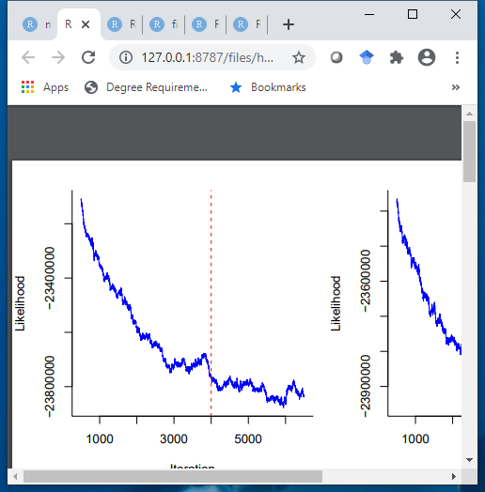
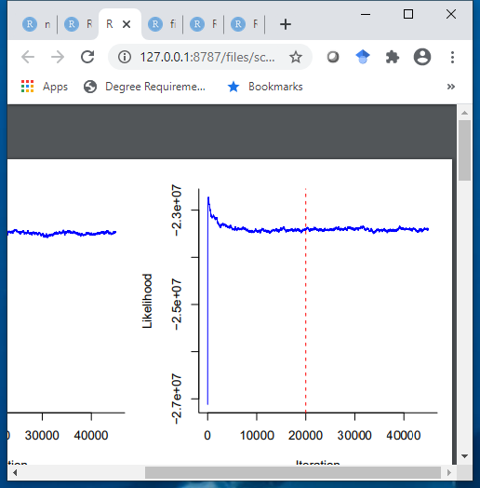
Diagnostics on burnin
Bad
Good
Burnin iterations
Burnin iterations

Slide 60
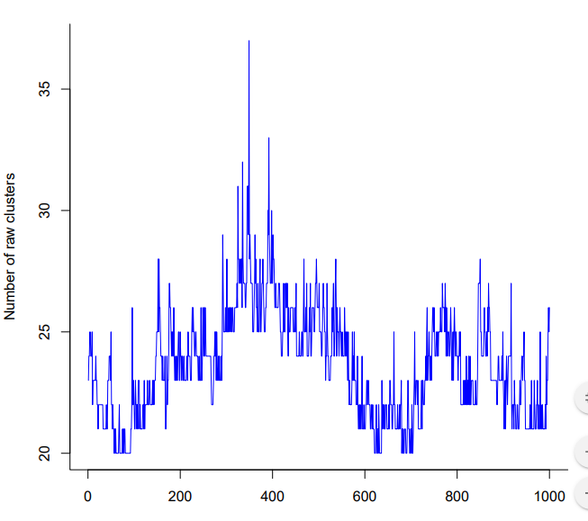
Part 2 Aligning and merging raw clusters to estimate mutational signatures
At each point in Gibb’s sampling chain the number of raw clusters (“aggregated partial spectra”) can vary
Therefore the raw clusters have to be aligned along the sampling chain, i.e. raw cluster 23 has to be the same at each sampled point in the chain
Sometimes clusters appear and disappear along the chain

Slide 61
Part 2 Aligning and merging raw clusters to estimate mutational signatures
There can be multiple independent sampling chains (e.g. run on different cores); clusters need to be merged across chains
Then very similar clusters still need to be merged
Some merged raw clusters are “noise” and are relegated to “signature 0”

Slide 62
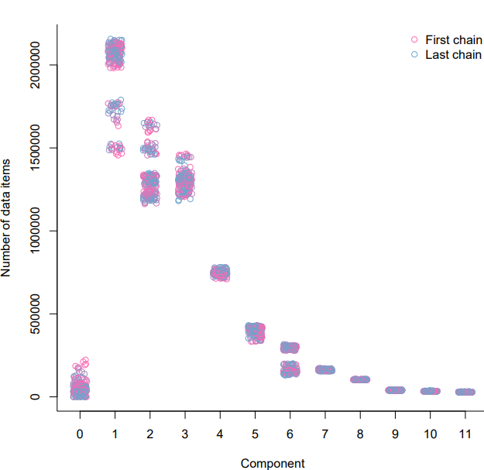
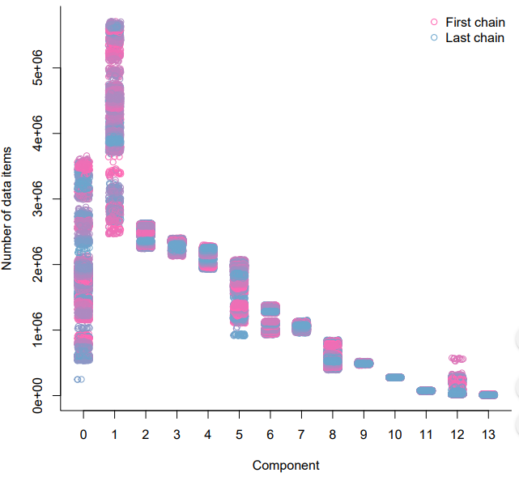
Allocation of mutations to signature (“component”) 0 seems to needs work; this seems to affect attribution, but not the accuracy of extracted signatures We think we can fix this
Number of mutations
Number of mutations
Good
Bad
Extracted mutational signature
Extracted mutational signature

Slide 63
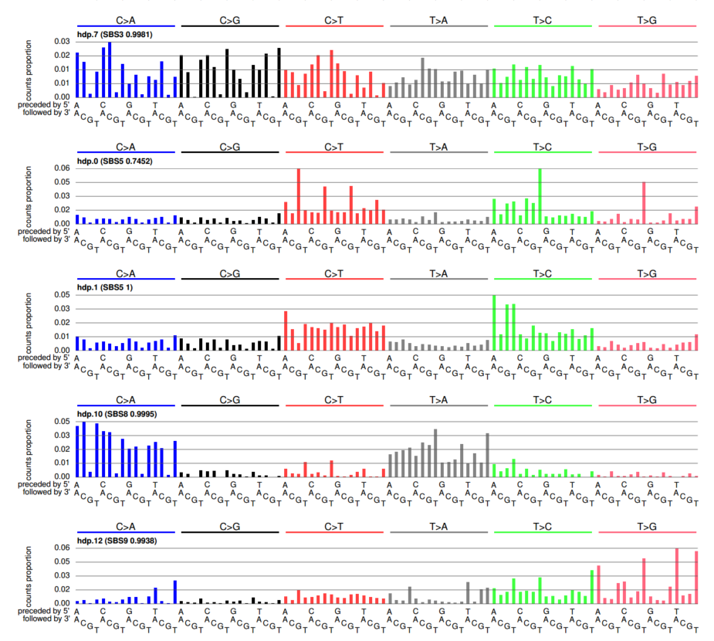
In synthetic data, often, except signature 0, all signatures very close to ground truth
Nearly perfect extraction of SBS3
Signature 0, a mixture of ground truth signatures SBS1, SBS5, SBS17a, SBS17b
Nearly perfect extractions of SBS5, SBS8, SBS9

Slide 64
Component 0 contains a mixture of ground truth signatures partly because of raw clusters (“aggregated partial spectra”) in the sampling chain that represent mixtures of ground truth signatures

Slide 65
Summary on data mining
Data mining for signature discovery (extraction) still evolving
We looked at two examples, SigProfilerExtractor and HDP
Both share some of the same issues, including the possibility of incomplete separation of signatures, over-separation of signatures (“over splitting”), and the related issue of determining the number of signatures
Both require dealing with some obvious and some not-so-obvious tuning parameters
Often researchers might be interested in more specific questions, such as
What known signatures are present in a set of spectra and how many mutations does each account for?
Are there novel signatures in a set of spectra?
Is a given signature present or absent in each of a set of spectra?
“Attribution” of known signatures (blue question above) is not well studied

Slide 66
Exercise
https://github.com/steverozen/ISMB.mutsig.tutorial/raw/master/exercise.in.interpreting.extraction.results.zip

